Slide 1

PROJECT 2
Star Schema ETL System
Recreating the BIClass Database
Team Members:
Andrew Laboy • Ralph Cange • Haroon Ahmed
Azm Karim • Mohamed Awad • Kazi Islam• Zenkai Gao

Slide 2
Project Overview
Objective
Key Components
• Transform messy source data into organized star schema
• Build 10 dimension tables + 1 fact table
• Implement ETL using SQL stored procedures
• Track workflow execution times
• Create JDBC application interface
Database: DIClass
Source: FileUpload.OriginallyLoadedData
Target: Star schema (10 dims + 1 fact)
Technology: SQL Server, Java JDBC
Team: 7 members

Slide 3
Technical Architecture
Star Schema Design
DimCustomer
DimTerritory
FACT TABLE
Sales Data
DimProduct
DimDate
+ 6 more dimension tables (Gender, Marital Status, Occupation, etc.)

Slide 4
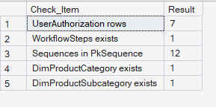
Ralph Cange: Database Architect
Ralph Cange
Responsibilities:
Key Deliverables
✓ Restored database from .bak file
✓ Created DbSecurity.UserAuthorization table (7 members)
✓ Created Process.WorkflowSteps table
✓ Created DimProductCategory & DimProductSubcategory
✓ Added audit columns to ALL existing tables
✓ Created PkSequence schema with 12 sequences
✓ Bonus: Helper procedures for workflow tracking
[Person 2: Add screenshot of SSMS showing your tables/sequences here]
Challenges & Solutions:
[Ralph: Every time I tried to DROP TABLE or DROP the UserAuthorization table, SQL Server didnt want to because other tables had foreign keys pointing to it. I had reverse the dependency chain before touching anything:]

Slide 5
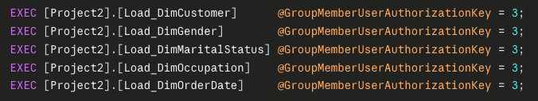
Person 3: ETL Developer 1
Haroon Ahmed
5 Dimension Loader Stored Procedures:
Load_DimCustomer
Load_DimGender
Loads all unique customer names from the raw data into a clean lookup table used by the fact tableCustomer master data
Loads the two gender values (M/F) from the raw data into a small reference tableGender lookup
Load_DimMaritalStatus
Load_DimOccupation
Loads distinct marital status codes (e.g. Married, Single) into a reference tableMarital status codes
Occupation cateLoads all unique job categories from the raw data into a lookup tablegories
Load_DimOrderDate
Loads all unique order dates along with their month name, month number, and year into a date reference tableDate dimension

Slide 6
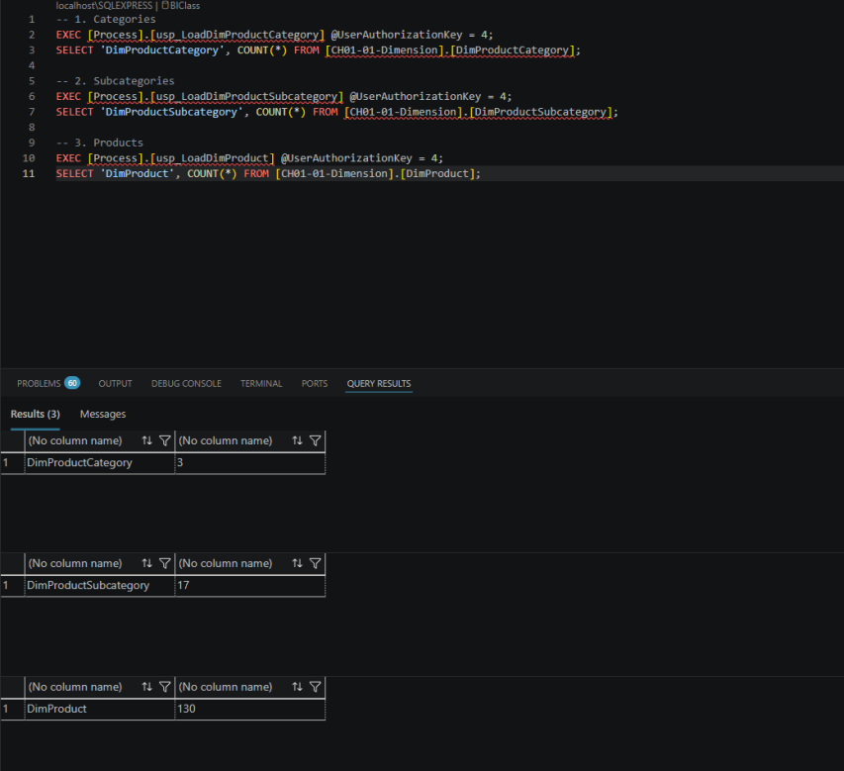
Person 4: ETL Developer 2
Azm Karim
3 Product Dimension Loaders:
run results:
1st
Load_DimProductCategory
first to establish the root primary keys
2nd
Load_DimProductSubcategory
next, using a JOIN on the newly created Category table to correctly map the ProductCategoryKey
3rd
Load_DimProduct
Loaded DimProduct last, joining to the Subcategory table to resolve the ProductSubcategoryKey.
The product tables had to be loaded in a specific order because each one depends on the one before it. We loaded DimProductCategory first, then DimProductSubcategory, and finally DimProduct last. Loading them out of order would cause a foreign key error and break the entire ETL

Slide 7
Person 5: ETL Developer 3 - FACT TABLE
Mohamed Awad
Dimension Loaders:
⭐ FACT TABLE LOADER
✓ Load_DimTerritory
✓ Load_DimSalesManagers
Load_Data: The Most Complex Procedure
Challenge: Join FileUpload.OriginallyLoadedData with ALL 10 dimension tables
Solution: INNER JOIN with each dimension to retrieve surrogate keys
Result: Fact table populated with proper foreign key relationships
Challenges: Initially I faced challenges understanding the pipeline and debugging the SQL procedures. Writing the joins across many tables felt overwhelming and it was a way to ensure the join conditions are correct.

Slide 8
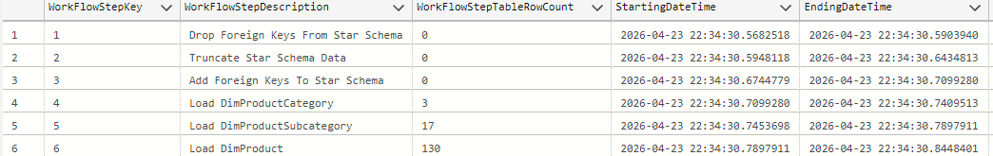
Person 6: Workflow Architect
Kazi Islam
Workflow Management & Orchestration:
usp_TrackWorkFlow
DropForeignKeys
Logs execution times & row counts for each SP
Removes FK constraints before truncate
TruncateStarSchema
AddForeignKeys
Clears all dimension & fact tables
Recreates FK constraints after load
LoadStarSchemaData
usp_ShowWorkflowSteps
Master orchestrator - calls all loaders in order
Query to display execution results
[Person 6: Add workflow diagram or execution time results screenshot]

Slide 9
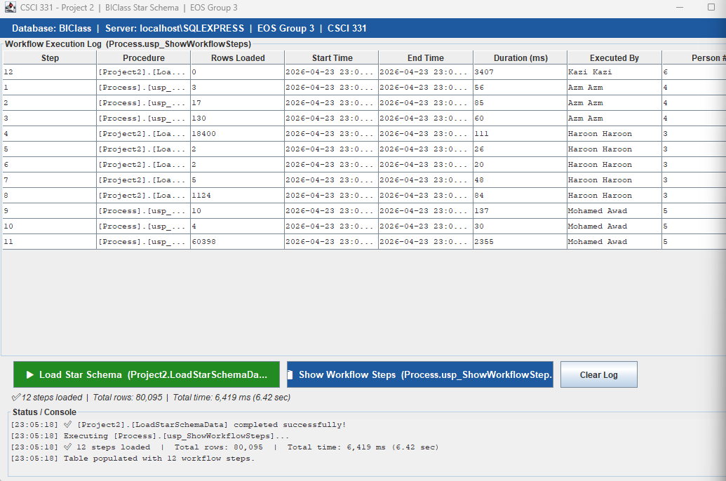
Person 7: JDBC Developer
Zenkai Gao
Java JDBC Application:
Application Features:
✓ Database connection to DLClass
✓ GUI with two main buttons:
• Execute ETL - runs LoadStarSchemaData
• Show Results - displays workflow data
✓ JTable displays execution times and row counts
✓ Error handling for database errors
✓ 8-minute demonstration video
[Person 7: Add screenshot of your Java GUI application here]

Slide 10
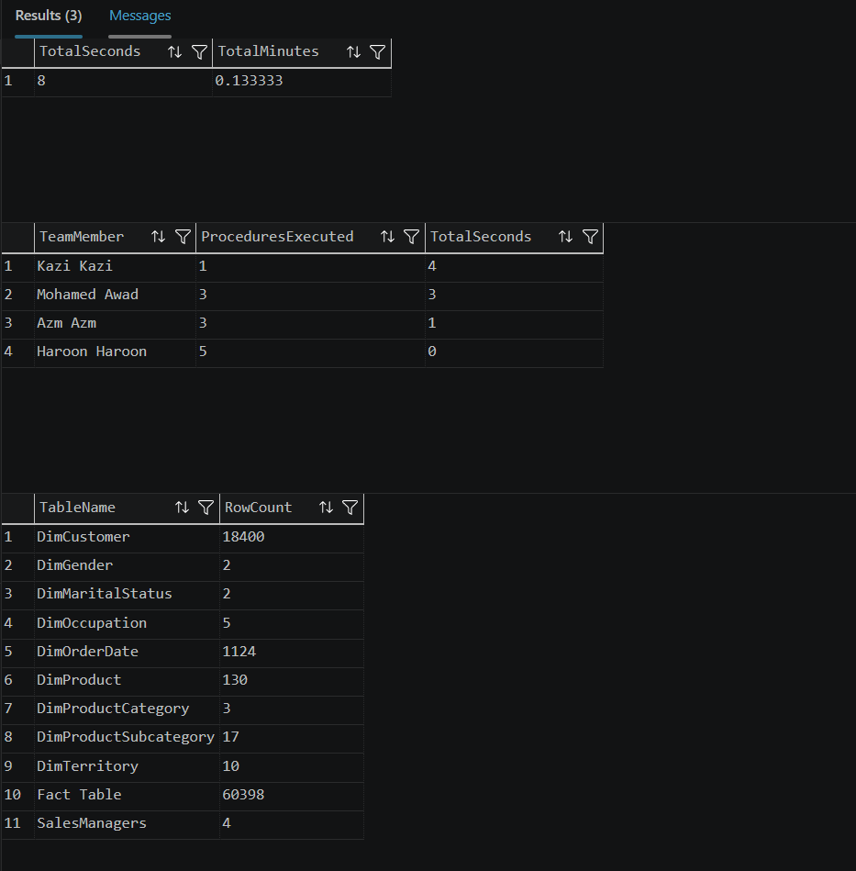
Person 1: Project Manager
Andrew Laboy
Project Coordination & Analysis:
✓ Coordinated 7-person team across a timeline
✓ Tracked dependencies and critical path
✓ Created AI briefing packages for each team member
✓ Wrote SQL analysis queries to measure performance
✓ Assembled final deliverables (PowerPoint, videos, VHDX)
✓ Recorded 12-minute SSMS demonstration video
Project Success Metrics:
✓ 80,095 total rows loaded | ✓ ETL completed in 4 seconds | ✓ 0 errors | ✓ Delivered on time

Slide 11
THANK YOU

